Slide 1
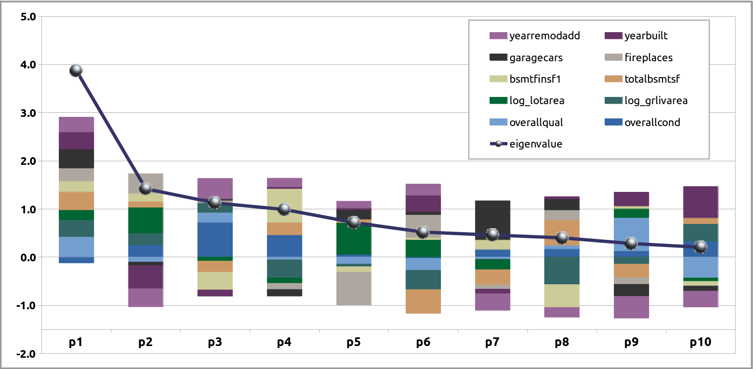
age related
Eigenvalues
amenities
basement features
size, area (sq-ft)
condition, quality

